Slide 1
Zomato Restaurants Analysis
By:
Akhilesh Yadav

Slide 2
Presentation Agenda
Majority Restaurant Type
Votes Received by Restaurant from Customers
Majority Restaurant Ratings
Number of Restaurants that Accept Online Orders
Couple's Average Spending on Online Orders
Ratings by Order Mode (Online vs. Offline)
Offline Order Preferences by Restaurant Type
Top Locations by Number of Restaurants Online
Most Popular Cuisines by Total Votes

Slide 3
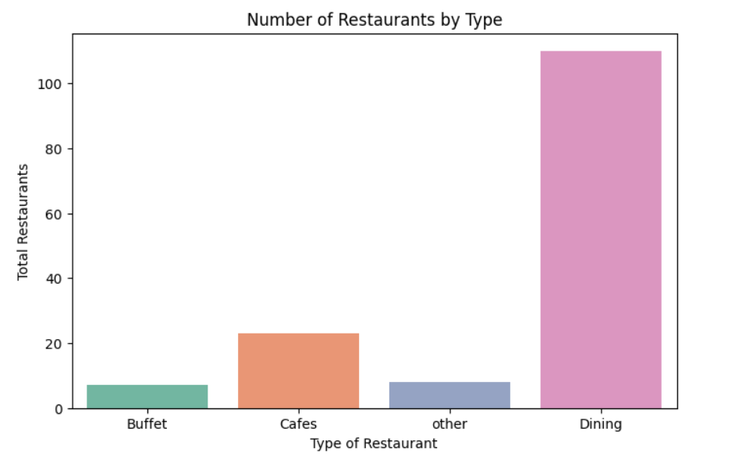
Majority Restaurant Type
The chart clearly shows that Dining Restaurants are the most preferred type among customers.
The number of Dining restaurants is significantly higher (over 100) compared to other types.
Cafes come in second place, while Buffet and Other types have very few orders.
Zomato can focus more on Dining outlets for targeted offers and better partnerships to boost customer satisfaction.

Slide 4
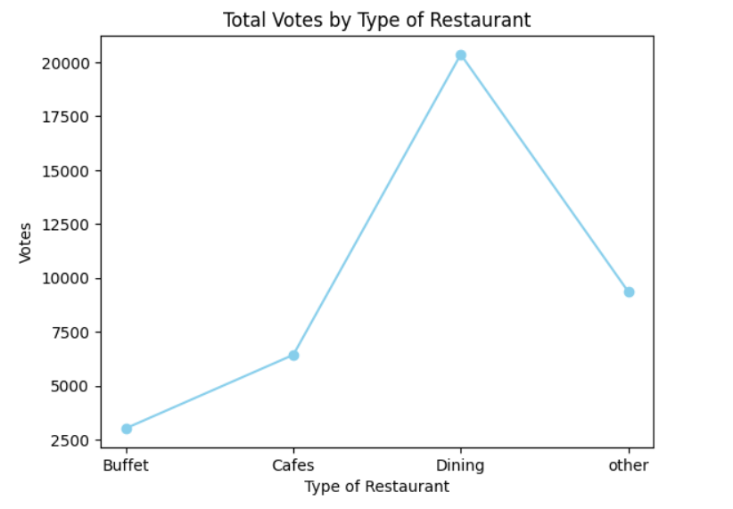
Votes Received by Restaurant Type from Customers
Dining restaurants have received the highest number of votes, crossing 20,000 votes, which indicates a high level of customer engagement and popularity.
Cafes follow with a moderate number of votes, showing decent customer attention.
Buffet and Other restaurant types have received comparatively very few votes, suggesting lower popularity or fewer customers interacting with those categories.
Zomato can leverage this insight by promoting more verified Dining options to attract customer confidence.

Slide 5
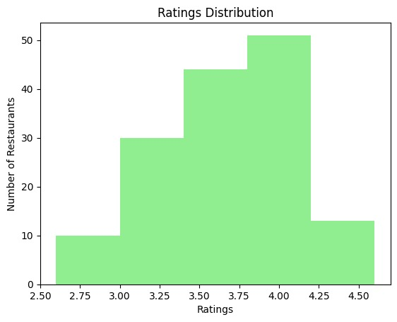
Majority Restaurants Ratings
Most restaurants fall in the 3.5 to 4.0 rating range, indicating that overall food quality and service are above average.
Very few restaurants have ratings below 3.0 or above 4.5, showing that customers usually rate restaurants moderately rather than extremely high or low.
This distribution suggests that Zomato restaurants maintain a consistent standard, with the majority performing satisfactorily in terms of quality, taste, and delivery.
Zomato can focus on helping lower-rated restaurants improve their performance to reach the industry average.

Slide 6
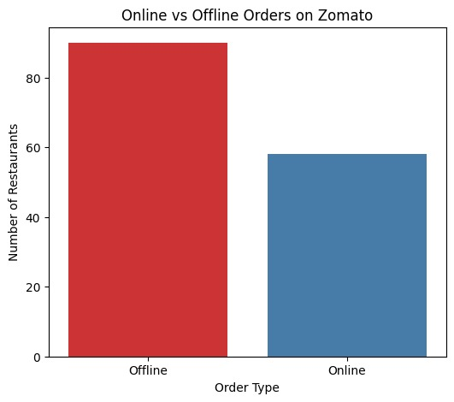
Number of Restaurant which Accept Online Order
The bar chart shows that offline restaurants are higher in number compared to those that accept online orders.
Around 90+ restaurants operate offline, while about 60 restaurants support online ordering.
This means a significant portion of restaurants are still not offering online ordering, which can be seen as a potential area for Zomato’s growth and digital expansion.

Slide 7
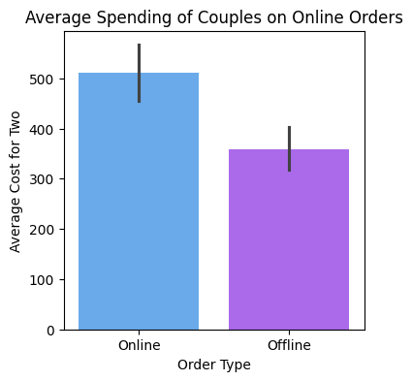
Average Spending by Couples on Online Orders
Zomato observes that couples predominantly order food online.
Their average spending per online order is approximately ₹500.
This spending is notably higher than what might be inferred for offline orders.

Slide 8
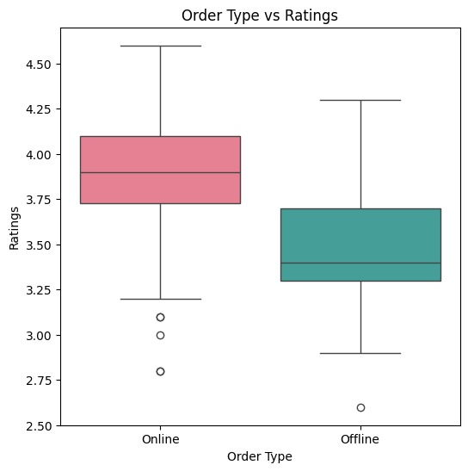
Online vs Offline: Highest Ratings Comparison
From the box plot, we can see that online orders consistently have higher ratings than offline orders.
The median rating for online mode is around 3.9–4.0, whereas for offline mode, it is around 3.4–3.5.
The overall spread (variation) of ratings is also less in online mode, showing more consistent customer satisfaction.
A few low-rating outliers exist for both modes, but they don’t affect the overall trend.

Slide 9
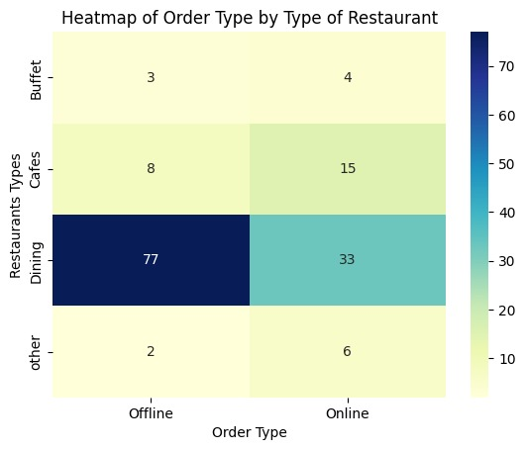
Restaurant Type and Order Mode Preferences
The heatmap clearly shows that Dining-type restaurants dominate the offline order segment with 77 offline orders, which is significantly higher than any other category.
Cafes and Buffets have relatively fewer offline orders, while Other types remain minimal.
This shows that dining restaurants are the most preferred for offline experiences.
Dining restaurants have received the highest number of offline orders, making them the ideal target for offline promotional campaigns and loyalty offers.

Slide 10
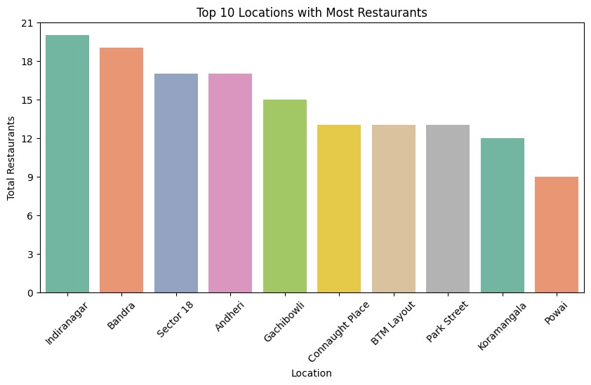
Top Restaurant Locations
Indiranagar, Bandra, and Andheri are the top 3 locations with the highest number of restaurants listed on Zomato.
These areas are identified as key food hubs, likely due to their popularity and diverse culinary offerings.
This makes it an ideal location for introducing new marketing campaigns, delivery offers, or premium listings to maximize visibility and sales.

Slide 11
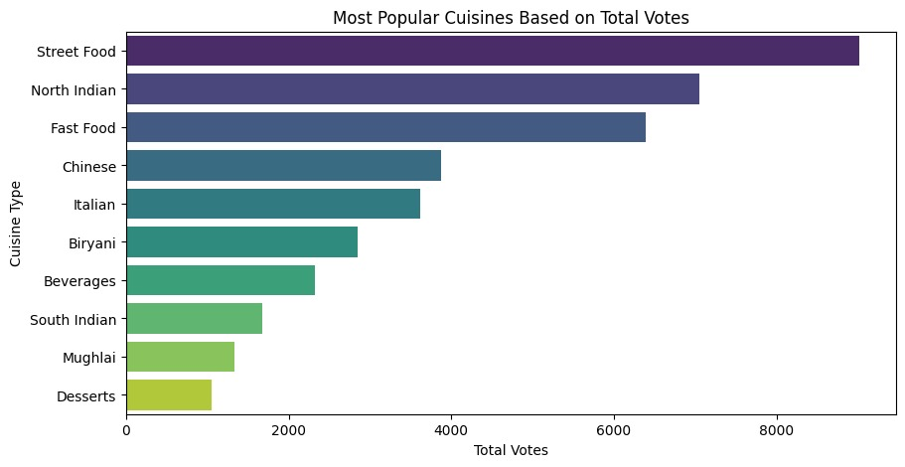
Most Popular Cuisines by Total Votes
Street Food and North Indian cuisines received the highest number of votes.
This indicates that these cuisines are the most popular and frequently ordered among Zomato users.
These categories could be the best focus for marketing campaigns, combo offers, or restaurant partnerships to maximize engagement and sales.

Slide 12
Conclusion Future Scope
The overall analysis of Zomato restaurant data shows that customers highly prefer Dining restaurants, followed by Cafes and Street Food outlets.
Most restaurants maintain ratings between 3.5–4.0, indicating good customer satisfaction.
Online orders are increasing in popularity and receive higher ratings than offline ones, showing the growing reliability of Zomato’s delivery system.
Overall, Zomato’s platform demonstrates consistent performance, strong customer engagement, and significant potential in expanding its online service reach.
Expand partnerships with small and mid-level restaurants to boost online adoption.
Implement AI-based recommendations to improve user experience and personalized offers.
Use data analytics to identify emerging food trends and plan targeted marketing campaigns.
Encourage low-rated restaurants through training, customer feedback tracking, and rating improvement programs.

Slide 13


